Slide 1

Space and Measurement
Rates of change
Incremental formula

Slide 2

Rates of Change
In differentiation, finding dy/dx means finding the rate of change of y with respect to x
If other variables are involved, e.g. volume and time, then we use differentiation to find dV/dt, the rate of change of volume with respect to time. E.g. dV/dt = 10 means the volume increases at the rate of
Positive rate: increase, negative rate: decrease
we can find the total change from given rates of change by using integration (antiderivative)

Slide 3
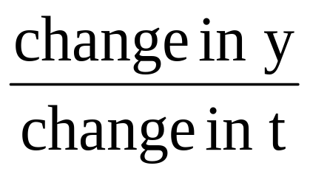

Rates of Change
Average rate of change = rate of change within a given time interval
=
Instantaneous rate of change = dV/dt
= rate of change at a particular moment
= slope/gradient of the tangent line at a point
Over short intervals of time, the average of change is approximately equal to the instantaneous rate of change

Slide 4

Rates of change
Example:
A colony of bacteria is increasing in such a way
that the number of bacteria present after t hours
is given by N where
Find the number of bacteria present initially
Find the number of bacteria present when t=5
Find the average rate of increase in the first 5 hours
Find an expression for the instantaneous rate of change of N with respect to t and hence find the rate the colony is increasing when t = 2
[120, 3870, 750, 620]

Slide 5
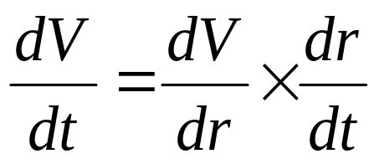
Rates of Change
To solve rate of change problems:
Find a function relating two variables, example V = 2 + 3.2r
Find the derivative, e.g. dV/dr
Find the value of dV/dr by substituting the r-value
Use the formula to find the rate of change for V or r.

Slide 6
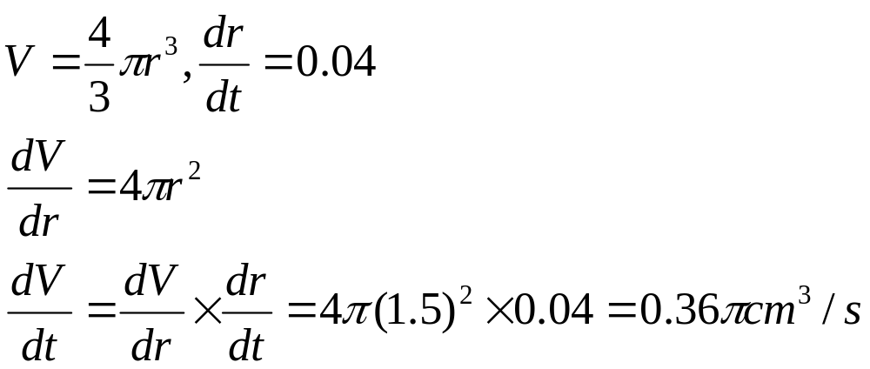
Example of rate of change
A spherical air bubble is formed at the base of a pond.
When the bubble moves to the surface of the water, it
expands. If the radius of the bubble is expanding at the
rate of 0.04cm/s, find the rate at which the volume of
the bubble is increasing when its radius is 1.5cm.

Slide 7
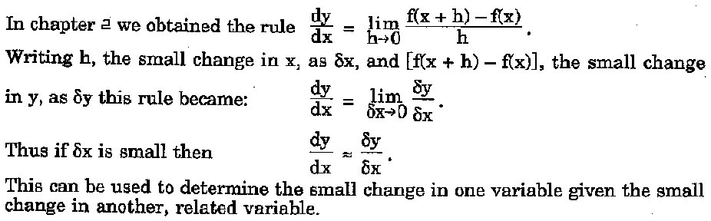
Small change

Slide 8
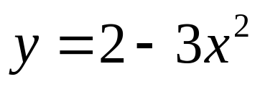
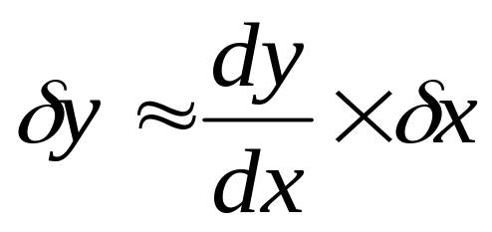
Small Change
To solve problems on small change:
Find a function relating two variables, example:
Find the derivative, e.g. dy/dx
Find the value of dy/dx by substituting the x-value
Use the formula to find the small change for y or x.
Positive value: increase, negative value: decrease

Slide 9
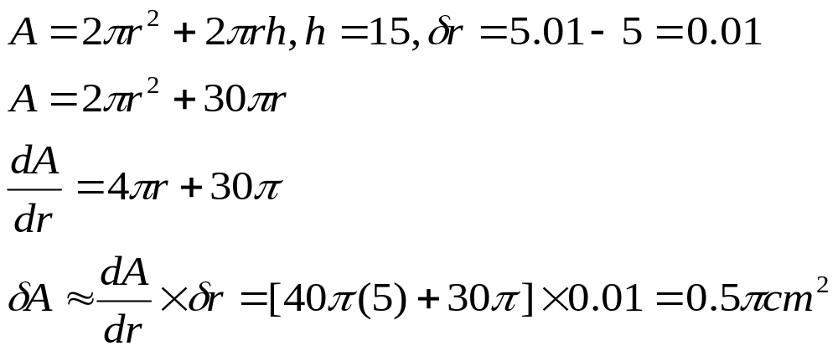
Example on small change
A closed cylinder has a height of 15cm. Find the
approximate increase in the total surface area of
the cylinder when the radius of the cylinder increases
from 5cm to 5.01cm while its height is a constant

